Slide 1
Notes:
MENU: INTRO & OBJECTIVES
No Audio
.

Slide 2
Amazon Redshift Basics
Presented by Annie (Hui) Sun

Slide 3


Topics in this Presentation
What is Redshift?
Redshift Architecture
Table Structure and Terminology
Loading Data
Query Processing
System Tables
Backups and Restore
Common issues and Case Handling
Q & A

Slide 4
What is Redshift?

Slide 5
Redshift Introduction
Fully managed, petabyte-scale data warehouse
Enterprise-class relational database query and management system
Supports client connections with many types of applications
OLAP Database Engine with columnar storage
Based on PostgreSQL 8.0.2
Uses raw disk to maximize performance

Slide 6


OLTP vs OLAP
Database engine can only be one or the other
Do NOT use Redshift as an OLTP database!!
Transactions
ETL
OLTP
OLAP
Reports

Slide 7
OLTP vs OLAP
 | OLTP | OLAP
Source of data | Operational data; usually the origin. | Log files; OLTP databases
Purpose of data | Control and run fundamental business tasks. | Help with planning,problem solving, and decision making
Loading data | Short and fast inserts or updates | Batch jobs
Queries | Simple queries returning relatively few rows | Complex queries involving aggregation
Schema design | Highly normalized with many tables | Typically de-normalized. Star schema
Backup and recovery | Backups very important and data loss is critical. | Can simply re-load the data

Slide 8
Row based storage vs Columnar
Sale ID | Store ID | Date | Category | Product | Quantity | Price
16 | Store 27 | 1/1/2013 | Produce | Banana | 5 | $2.20
35 | Store 11 | 1/2/2013 | Frozen Foods | Pizza | 2 | $6.80
135 | Store 32 | 1/2/2013 | Frozen Foods | Ice cream | 1 | $3.15
151 | Store 5 | 1/3/2013 | Dairy | Milk | 3 | $2.00
190 | Store 6 | 1/4/2013 | Bakery | Bread | 1 | $1.55

Slide 9
Row based storage
Typically used in OLTP databases
Data organized as a B-Tree
Sale ID | Store ID | Date | Category | Product | Quantity | Price
16 | Store 27 | 1/1/2013 | Produce | Banana | 5 | $2.20
35 | Store 11 | 1/2/2013 | Frozen Foods | Pizza | 2 | $6.80
135 | Store 32 | 1/2/2013 | Frozen Foods | Ice cream | 1 | $3.15
151 | Store 5 | 1/3/2013 | Dairy | Milk | 3 | $2.00
190 | Store 6 | 1/4/2013 | Bakery | Bread | 1 | $1.55
122
Leaf Nodes or Pages. Normally 8K or 16K
65
136 151
16-Row
35-Row
65-Row
66-Row
97-Row
122-Row
123-Row
135-Row
136-Row
139-Row
150-Row
151-Row
160-Row
190-Row
650-Row
16:Store27, 1/1/2013, Produce, Banana, 5, $2.20; 35:Store 11,….;….; 190: Store 6…;

Slide 10
Columnar Storage in Redshift
Columns stored independently
Data blocks store column values
Blocks linked in sequence
1MB Blocks
Row order preserved
Scan friendly structure
New values appended to the end
No indexes No random access
Compression to save space and IO
Sale ID
16 35 135
Store ID
Store 27 Store 11
Date
1/1/2013 1/2/2013 1/2/2013 1/3/2013
151
Store 32
Store 5
1/4/2013
190
Store 6

Slide 11




Columnar storage DBMS

Slide 12
More Features
Scale Out: Resize capability
Fully SQL Compatible
Optimized data import & export: Parallel across all nodes
Efficient Aggregates & Joins
Local Storage
No single point of failure

Slide 13
Architecture

Slide 14
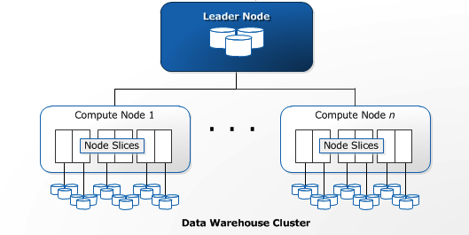
Redshift Architecture
Leader Node: develops execution plans to carry out database operations
Compute Nodes: executes the compiled code and send intermediate results back to leader
Node Slices: partitions of a compute node

Slide 15
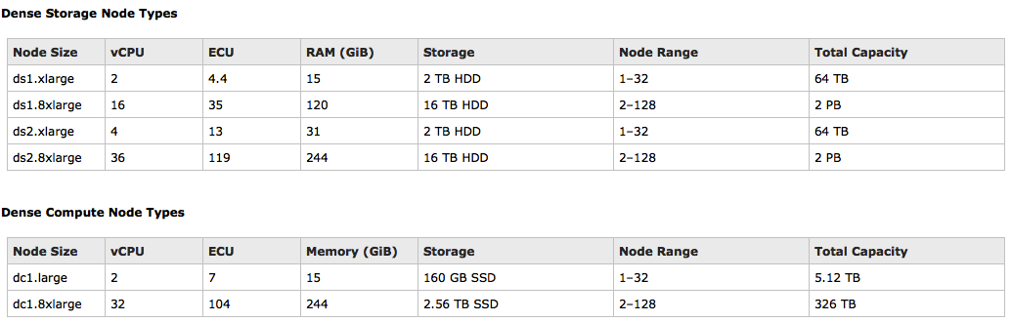
Redshift Architecture
Dense storage xlarge has 2 slices, 8xlarge has 16 slices
Dense compute large has 2 slices, 8xlarge has 32 slices

Slide 16

Inside a Compute Node
CPU Core
CPU Core
Create table test (id int, name varchar(100));
INSERT INTO test VALUES (1, “Bob”), (2, “Alice”);
id | name | IX | DX | RI
.. | … | … | … | …
id | name | IX | DX | RI
.. | … | … | … | …
160 GB
Slice 0
Slice 1
160 GB
Replicated data
Replicated data
Compute Node – dc1.large, 2 vCPU, 160 SSD

Slide 17
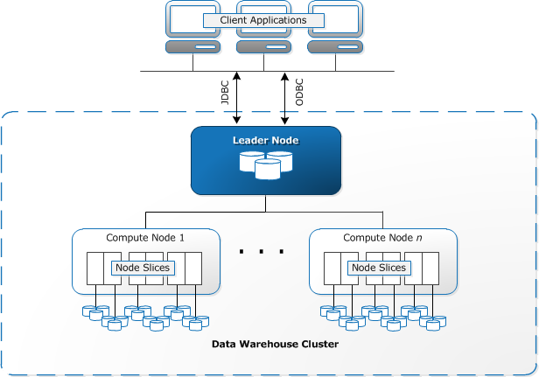
Redshift Architecture

Slide 18
Control Plane
Very similar to the Control Plane of RDS
Customer VPC (eth1) + Redshift VPC (eth2)
Host Manager + Event Processor (Tomcat Java)
AdminWorkflows + Admin DB
No Observed Events
Coral Web Service (No Customer API)

Slide 19
Cluster Properties
Node Type & # of Nodes
Cluster Type (Single Node/Multi Nodes)
Parameter Group
Encryption (KMS/HSM/None)
Subnet Group/VPC
Publicly Accessible (EIP)
Availability Zone & Security Group
Cannot be changed once cluster is created

Slide 20
Resizing
Single node and multi-node
Resize between the cluster types
Resize between cluster sizes
Make sure there’s enough space on the resized cluster
May need to re-distribute the data
Cluster becomes READ-ONLY

Slide 21

Resizing
Create the destination cluster
Initiate the resize
Start Copying the data over
Finish the Resize and flip Endpoint
Source Cluster
example.cphcouytanwb.eu-west-1.redshift.amazonaws.com
client
Read Only
client
example.cphcouytanwb.eu-west-1.redshift.amazonaws.com
Target Cluster

Slide 22
Connectors and Clients
Redshift JDBC (4.1/4.0) and ODBC drivers
SQL Workbench/J, Aginity
psql 8.x via command line
Partners with Tableau, Microstrategy, Informatica, etc
More partner info : http://aws.amazon.com/redshift/partners/

Slide 23
Table Schema

Slide 24
New Concepts
Sort key
column(s) that the data is sorted on
creates a sorted region and unsorted region
Distribution style: Determines where the data is stored on the cluster
Encoding
Columnar storage can be easily compressed as it is same data type
Use different encoding for different columns
# CREATE TABLE test (id int, name varchar(100) encode lzo)
DISTSTYLE even
SORTKEY(id);

Slide 25
Minimum Table Size
# of columns (+ 3 hidden columns per table)
# of slices / node
# of nodes
# of regions (sorted and unsorted)
Formula: (# of columns + 3 hidden columns) * # of slices/node * # of nodes * # of regions
# CREATE TABLE test (id int, name varchar(100) encode lzo)
DISTSTYLE even
SORTKEY(id);
2-node dc1.large: (2 cols + 3 hidden cols) * 2 slices/node * 2 nodes * 2 regions = 40 MBs
2-node dc1.8xlarge:
(2 cols + 3 hidden cols) * 32 slices/node * 2 nodes * 2 regions = 640 MBs
The minimum table size grew by 8x

Slide 26
Minimum table size - Visualized
# CREATE TABLE test (id int, name varchar(100) encode lzo) DISTSTYLE even SORTKEY(id);
# INSERT INTO test VALUES (1, ‘Bob’), (2, ‘Alice’), (3, ‘Jack’), (4, ‘Jill’);
Table size: (2 cols + 3 hidden cols) x 2 slices/node x 2 nodes x 2 regions = 40 MBs
id | name | IX | DX | RI
.. | … | … | … | …
id | name | IX | DX | RI
.. | … | … | … | …
id | name | IX | DX | RI
.. | … | … | … | …
id | name | IX | DX | RI
.. | … | … | … | …
Sorted
Unsorted
Sorted
Unsorted
Slice 0
Slice 0
id | name | IX | DX | RI
.. | … | … | … | …
id | name | IX | DX | RI
.. | … | … | … | …
id | name | IX | DX | RI
.. | … | … | … | …
id | name | IX | DX | RI
.. | … | … | … | …
Sorted
Unsorted
Sorted
Unsorted
Slice 1
Slice 1
Compute Node 0 – dc1.large, 2 vCPU, 160 SSD
Compute Node 1 – dc1.large, 2 vCPU, 160 SSD

Slide 27
Good Schema Design
Most of query performance issues and database errors are due to poor schema design or poor schema maintenance
What is considered good schema design?
Choosing the right sort key style and keys
Choosing the right distribution style and key
Use the correct encoding
Always use the smallest column needed
Use datetime instead of characters for timestamps
Use constraints to help the query planner

Slide 28
What is Sort Key?
Data will be sorted on the slices according to the sort key column(s)
Sorted and unsorted region
Define sort key on the frequently filtered columns
Sort key styles
Compound Sort Key: weight is given to the columns in defined order
Interleave Sort key: equal weight among all sort key columns
Growing unsorted region = performance degradation
Data is sorted when loading to an empty table
VACUUM [SORT ONLY]

Slide 29
Tables zoomed in
Id (Sort Key)
name
Id (Sort Key)
name
1
Bob
9
5
…
Sandra
John
…
2
…
…
…
…
Jeff
sorted
unsorted
Data will only be loaded into sorted region when it is empty
Will keep adding to the same block in unsorted region until the data reaches 1MB.

Slide 30
VACUUM [SORT ONLY]
Id (Sort Key)
name
Id (Sort Key)
name
1
Nathan
9
5
…
Sandra
John
…
2
…
Jeff
…
5
…
9
John
…
…
2
…
…
…
…
Sandra
…
Jeff
sorted
unsorted
VACUUM [SORT ONLY] will sort the rows in sort key order
Data will be in sorted region after VACUUM completes

Slide 31
Comparing Sort Styles
-- single sort key
# create table cust_sales_date_single sortkey (c_custkey) as select * from cust_sales_date;
-- compound sort key
# create table cust_sales_date_compound compound sortkey (c_custkey, c_region, c_mktsegment, d_date) as select * from cust_sales_date;
-- interleave sort key
# create table cust_sales_date_interleaved interleaved sortkey (c_custkey, c_region, c_mktsegment, d_date) as select * from cust_sales_date;
Ordered by first sort key.. Then second .. etc
All Sort keys have equal weight

Slide 32
Comparing Sort Styles
-- Query 1
# select max(lo_revenue), min(lo_revenue) from <table_name> where c_custkey < 100000;
-- Query 2
# select max(lo_revenue), min(lo_revenue) from <table_name> where c_region = 'ASIA' and c_mktsegment = 'FURNITURE';
-- Query 3
# select max(lo_revenue), min(lo_revenue) from <table_name> where d_date between '01/01/1996' and '01/14/1996' and c_mktsegment = 'FURNITURE' and c_region = 'ASIA';
Reminder: sortkey (
c_custkey,
c_region,
c_mktsegment,
d_date)

Slide 33
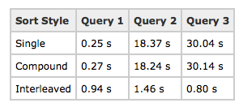
Comparing Sort Styles
Performed with tables with 480 million rows
2-node cluster
Choosing your sort style should depend on the queries that you run on the table
Importance of good table schema design
Use only first sort key
Use second and third sort key
Use fourth, third then second sort key

Slide 34
What is Distribution?
Determine where in the cluster the data will be placed
Distribution styles
EVEN: round-robin style when loading data, one row on every slice
KEY: Groups similar data together to avoid redistribution
ALL: all the data in the table reside on first slice of every node
Goals of Data Distribution
Distribute the workload evenly among the nodes
Minimize data movement during query execution

Slide 35
Distribution Skew
# CREATE TABLE public.distribution_skew (id INT, customer CHAR(255) DISTKEY, dt TIMESTAMP );
400 million row table
90% of the values for customer is ‘Amazon.com’
Causes 90% of the data to all fall under one node
That particular slice will work much more than the rest of the nodes
Can potentially cause OOM and Disk Full issues
How to resolve this:
Change distribution key to have more even distribution or change to EVEN distribution all together
Redistribution vs skew

Slide 36
Distribution Skew - Visualized
CPU Core
CPU Core
CPU Core
CPU Core
id | name | IX | DX | RI
.. | … | … | … | …
id | name | IX | DX | RI
.. | … | … | … | …
… | …. | …. | ….. | …..
id | name | IX | DX | RI
.. | … | … | … | …
id | name | IX | DX | RI
.. | … | … | … | …
…. | …. | …..
…. | ….. | ….
…. | ….. | …..
Slice 0
Slice 1
Slice 0
Slice 1
Compute Node 0 – dc1.large, 2 vCPU, 160 SSD
Compute Node 1 – dc1.large, 2 vCPU, 160 SSD
5 s
350 ms
When you have a distribution skew of 2.0,how will this impact your query performance?
It may run up to 2x slower

Slide 37
Compression Encoding
Tables should always use encoding (except for the very small tables)
Reduces footprint on disk
Reduces Disk I/O when data is loaded into memory
Query gets decompressed during query execution
More Information on encoding style: http://docs.aws.amazon.com/redshift/latest/dg/c_Compression_encodings.html

Slide 38
Testing Compression Encoding
# ANALYZE COMPRESSION <table_name>
# CREATE TABLE encodingcolumns (
columnraw varchar(100) encode raw,
columnbytedict varchar(100) encode bytedict,
columnlzo varchar(100) encode lzo,
columnrunlength varchar(100) encode runlength,
columntext255 varchar(100) encode text255,
columntext32k varchar(100) encode text32k);
# select col, max(blocknum)
from stv_blocklist b, stv_tbl_perm p
where (b.tbl=p.id) and name=‘encodingvenue’ and col < 6
group by name, col
order by col;

Slide 39
Defining Constraints
Constraints are not enforced by Redshift
Used as planning hints
E.g. Query planner uses PK and FK in certain statistical computations
Assumes that all keys in Redshift are valid as loaded
Constraint enforcement should be done prior to loading into the cluster
NOT NULL column constraints are enforced
IMPORTANT: If constraints are not enforced, it can lead to incorrect query results.

Slide 40
Schema design ROT
Sort key – frequently filtered columns
Compound: when a prefix of the sort key columns is used to filter data
Interleaved: when the combination of columns filtered is unknown
Distribution – frequently joined columns
Key: joins are frequently performed and creates even distribution
ALL: not frequently updated, relatively small in size tables
EVEN: when key doesn’t produce a even distribution
Encoding – Cost of decompression vs I/O saved
Constraints – Make sure they are enforced

Slide 41
Loading Data

Slide 42
Loading Data
COPY
The most efficient way to load a table
via S3,DynamoDB, SSH
Can help with compression if table is empty
INSERT
Bulk inserts are supported but not as efficient as COPY
COMMIT Queueing
As Redshift is an OLAP database, it is more recommended to group the data together as much as possible to load together

Slide 43
Loading Data Best Practices
Use COPY
Use a Single COPY command
Split your data to multiple files (between 1MB to 1GB)
Compress your files to GZIP or LZOP
Load data in Sort Key order
Load data in Sequential Blocks
Use a staging table to load
Use a time series table
Use a manifest file
Use a bulk insert or multi-row insert

Slide 44



COPY with S3 - Visualized
id | name | IX | DX | RI
.. | … | … | … | …
id | name | IX | DX | RI
.. | … | … | … | …
id | name | IX | DX | RI
.. | … | … | … | …
id | name | IX | DX | RI
.. | … | … | … | …
Slice 0
Slice 1
Slice 0
Slice 1
Compute Node 0 – dc1.large, 2 vCPU, 160 SSD
Compute Node 1 – dc1.large, 2 vCPU, 160 SSD

Slide 45
DELETE
Once data is inserted, it cannot be changed
DELETE/UPDATE (Delete + Insert)
Rows are marked as deleted but space is not reclaimed back
Spaces will not be reused
Causes stale statistics and inaccurate query planning
Id (Sort Key)
name
Id (Sort Key)
name
1
Nathan
x
2
Jeffery
2
…
Jeff
…
5
…
9
John
…
…
…
Sandra
sorted
unsorted

Slide 46
VACUUM
Cluster may become slow and query performance degrade
Large unsorted region, stale statistics etc
VACUUM [SORT ONLY/DELETE ONLY/FULL/REINDEX]
Load in sort key order to lessen frequency of VACUUM
VACUUM FULL will
Sort the data in sort key order
Remove rows that are marked for deletion,reclaim space
Downside of VACUUM:
May need at least 2x the size of the table
Very large tables are not recommended

Slide 47
Deep Copy
Alternative to VACUUM
More suitable for larger tables
Syntax:
# CREATE TABLE deep_copy_table (like <table_name>);
# INSERT INTO deep_copy_table SELECT* FROM <table_name>;
Will be in sorted order and defragmented when complete
Require less space than VACUUM

Slide 48
Query Processing

Slide 49
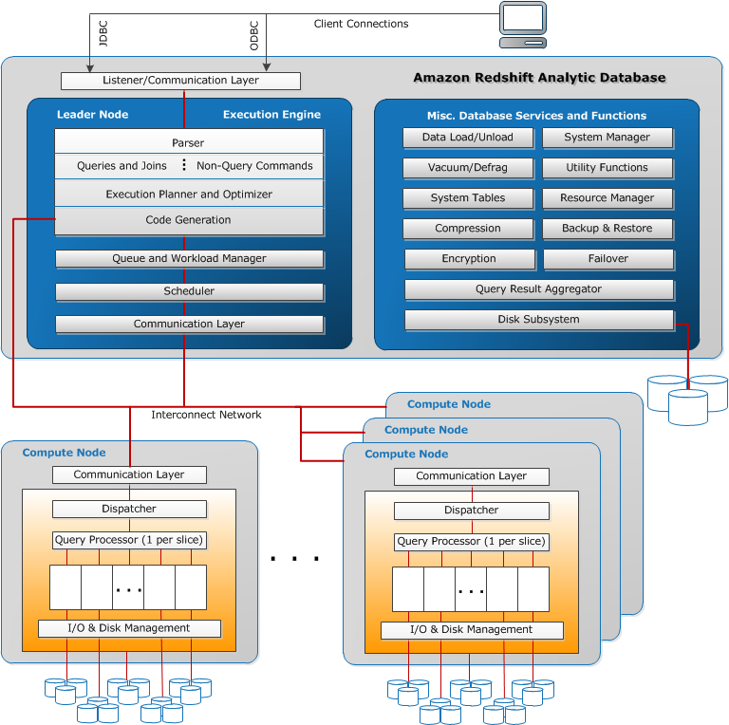
Redshift Internal Architecture

Slide 50
Query Lifecycle
client
JDBC
ODBC
Parser
Explain Plans
Generate code for all segments of one stream
Query Planner
Code Generator
Final Computations
Return results to client
Leader Node
Receive Compiled Code
Receive Compiled Code
Run the Compiled Code
Run the Compiled Code
Segments in a stream are executed concurrently. Each step in a segment is executed serially.
Return results to Leader
Return results to Leader
Compute Node
Compute Node

Slide 51
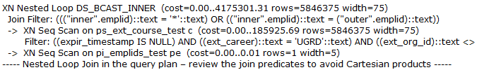
Explain Plan
Produced by the Query Planner
Used by code generator to generate compiled code
# EXPLAIN <query>;
# SELECT rtrim(plannode) as plannode, substring(info from 1 for 50) from STL_EXPLAIN where query=<query_id> order by query, nodeid;
EXPLAIN plans are read starting at the BOTTOM.
Identify the steps there jump in COST is the largest. This is the most expensive step.
Look for JOIN steps like DS_DIST_BOTH, DS_BCAST_INNER, DS_DIST_ALL_INNER
Fix these steps with a better distribution key
Make sure statistics are updated!

Slide 52
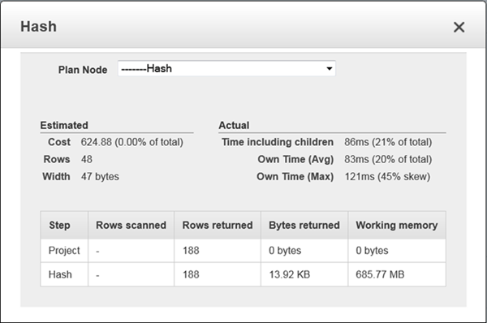
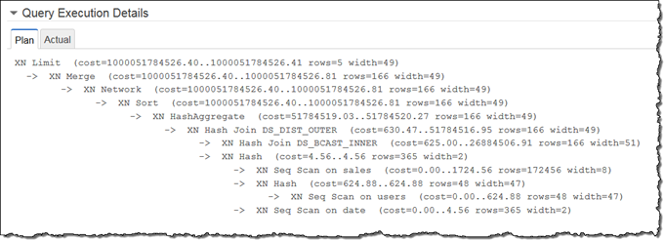
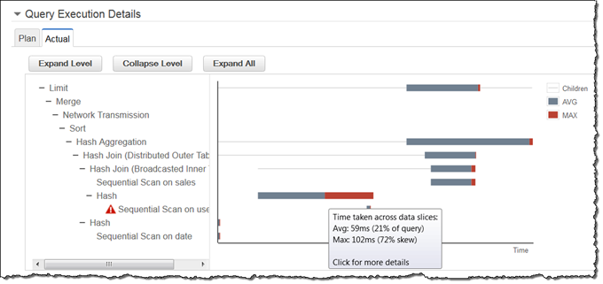
Visual Explain Plan

Slide 53
Workload Management
Used to handle query bottlenecks
Create queues for the long running queries and short queries
Sets priorities correctly
Manages concurrency for the cluster
If optimized, then cluster should not be overloaded
Set wlm_query_slot_count to temporarily override concurrency
WLM Queueing

Slide 54
Defining the Queues
Concurrency Level
Superuser queue/User Groups/Query Groups
WLM Memory Percent to Use
WLM Timeout

Slide 55
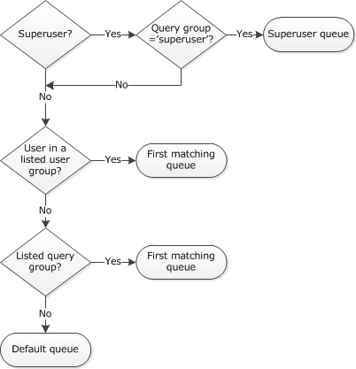
WLM Assignment Rules
[ { “query_group”:[“hammerstone”,“datanet”, “etlm”,” hs” ], “user_group”:[“hs_prod_etl_grp”, “datanet_etl_grp” ], “query_group_wild_card”:0, “user_group_wild_card”:0, “query_concurrency”:7, “max_execution_time”:0, “memory_percent_to_use”:50 }, { "query_group":["support_analysts” ], "user_group":["support_analysts”], "query_group_wild_card":0, "user_group_wild_card":0, "query_concurrency":5, "max_execution_time":0, "memory_percent_to_use":40 }, { "query_group":["adhoc” ], "user_group":["awsdw_ro_grp” ], "query_group_wild_card":0,"user_group_wild_card":0, "query_concurrency":3, "max_execution_time":3600000, "memory_percent_to_use":5 }, { "query_group":[ ], "user_group":[ ], "query_group_wild_card":0, "user_group_wild_card":0, "query_concurrency":1, "max_execution_time":0, "memory_percent_to_use":5 } ]
User: hssun
User group: awsdw_ro_grp
User: testuser
User group: -
Set query_group to ‘etlm’;

Slide 56
System Tables

Slide 57
System Tables
Most essential to troubleshooting Redshift problems
Understanding the system tables is the key to understanding Redshift
What data is being logged?
What is data is needed?
In addition to pg_catalog
Contain information about how the system is functioning
Superuser visible and user visible
STL tables/SVL views: generated from logs that have been persisted to disk to provide a history of the system
STV tables/SVV views: virtual tables that contain snapshots of the current system data

Slide 58
STL Tables
STL_QUERY
STL_ERROR
STL_LOAD_COMMITS
STL_LOAD_ERRORS
STL_EXPLAIN
STL_VACUUM
STL_CONNECTION_LOG
STL_COMMIT_STATS
STL_INSERT/STL_DELETE

Slide 59
STV Tables and Views
STV_INFLIGHT/STV_RECENTS
STV_TBL_PERM
STV_EXEC_STATE
STV_BLOCKLIST
STV_STARTUP_RECOVERY_STATE
STV_ACTIVE_CURSORS
SVL_COMPILE
SVV_INTERLEAVED_COLUMN/SVV_TABLE_INFO
SVL_QUERY_REPORT/SVL_QUERY_SUMMARY
SVL_STATEMENTTEXT
SVV_VACUUM_PROGRESS/SVV_VACUUM_SUMMARY

Slide 60
Example Queries
-- Get a specific query info
# select aborted, userid, xid, pid, query, substring(trim(querytxt), 0, 100), starttime, endtime, datediff(s, starttime, endtime) from stl_query where <filters> order by starttime;
-- Number of commits performed per day with maximum queuelen
# select trunc(startqueue) dt, count(*), max(queuelen) from stl_commit_stats where node=-1 group by 1 order by 1;
-- Query breakdown
# select query, stm, seg, step, rows, workmem, bytes, label, is_diskbased from svl_query_summary where query = <query_id> order by stm, seg, step;
-- All tables scanned in a query
# select*from svv_table_info where table_id IN (select distinct tbl from stl_scan where query=<query_id>) order by size desc;
Lots of links in the wiki for queries.

Slide 61
CloudWatch
CloudWatch monitoring is available for metrics
Queries
CPU Utilization
NetworkReceiveThroughput/NetworkTransmitThroughput
WriteIOPS/Throughput/Latency
ReadIOPS/Throughput/Latency
Database Connections
Health Status
Maintenance Mode
Percentage Disk Spaced Used
If Health Status = 0, will always auto generate SEV2 for Ops
If in Maintenance Mode, cluster will not go into Unhealthy
Nominal space

Slide 62
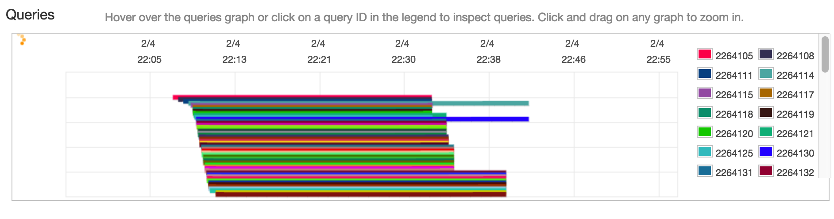
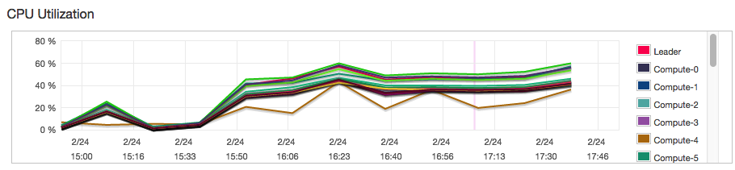
CloudWatch
All metrics except for Queries are cluster based and query based

Slide 63
Database Audit Log
Not enabled by default
Stored in S3
Log Files
Connection log – authentication attempts
User log – changes to database user definitions
User activity log – logs each query before it runs
Ensure Redshift has permission to upload the logs
Supports CloudTrail independently of audit logs
How to enable:
http://docs.aws.amazon.com/redshift/latest/mgmt/db-auditing-console.html

Slide 64
Backup and Restore

Slide 65
Backups
Snapshots (very similar to EBS snapshots)
Point in time restore backup of a cluster
Automated Snapshots
taken around every 8 hours or every 50GB of new data
only kept for specified retention period
Manual Snapshots
can be taken regardless of automated snapshots
no limited retention period, persist through cluster deletion
Stored in S3 via SSL Connection
Cross region snapshot copy
Can be shared across accounts

Slide 66
Restore
Using snapshots
Always restore to a new cluster
2 phase restore process
Phase 1: create the cluster and download all the super blocks
Cluster is available and queryable after phase 1 is complete
May experience some performance degradation
Phase 2: download rest of the blocks from S3
This process may take a little bit longer

Slide 67
Restore - Visualized
Create the restored cluster
Download superblocks from S3
Download rest of the blocks
Can perform all reads and writes once cluster is available
All slices perform restore in parallel
On demand restore of blocks
example.cphcouytanwb.eu-west-1.redshift.amazonaws.com
client
Superblocks
Rest of the blocks

Slide 68
UNLOAD
Opposite of COPY
Upload the result of a query to S3 in datafiles
Run in parallel across all compute nodes
Splits results of a SELECT statement across a set of files
-- Example Unload
# unload ('select * from venue') to 's3://mybucket/tickit/unload/venue_' credentials 'aws_access_key_id=<access-key-id>;aws_secret_access_key=<secret-access-key>';
Can choose to return manifest file

Slide 69
UNLOAD - Visualized
id | name | IX | DX | RI
.. | … | … | … | …
id | name | IX | DX | RI
.. | … | … | … | …
id | name | IX | DX | RI
.. | … | … | … | …
id | name | IX | DX | RI
.. | … | … | … | …
Slice 0
Slice 1
Slice 0
Slice 1
Compute Node 0 – dc1.large, 2 vCPU, 160 SSD
Compute Node 1 – dc1.large, 2 vCPU, 160 SSD

Slide 70
Common issues & Case Handling

Slide 71
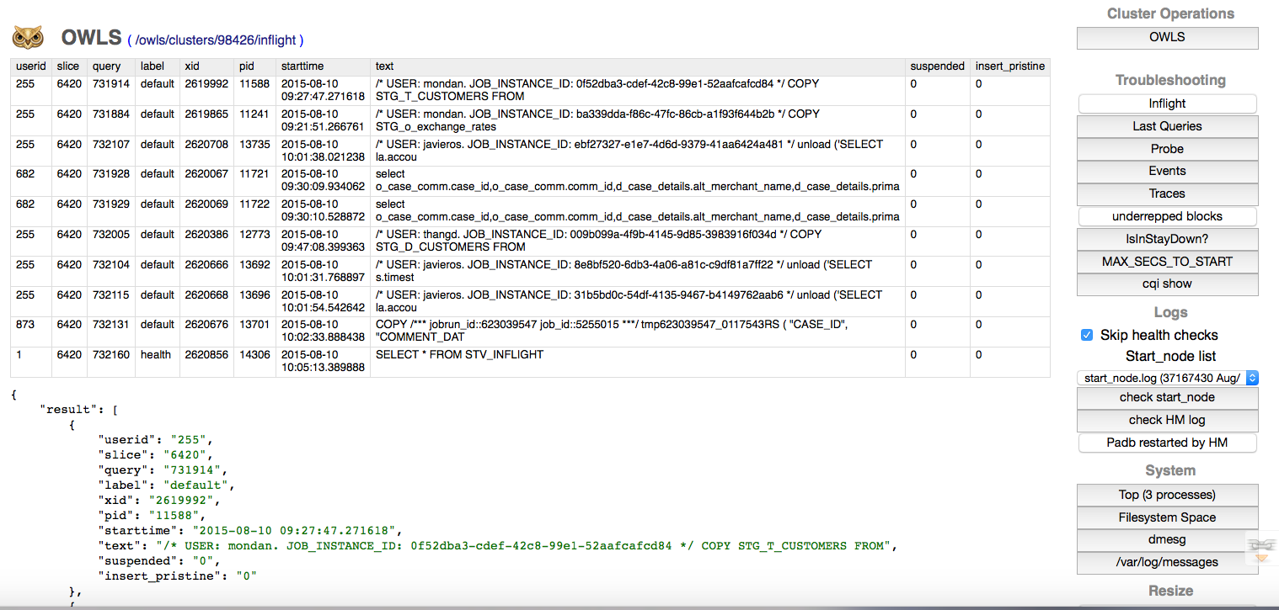
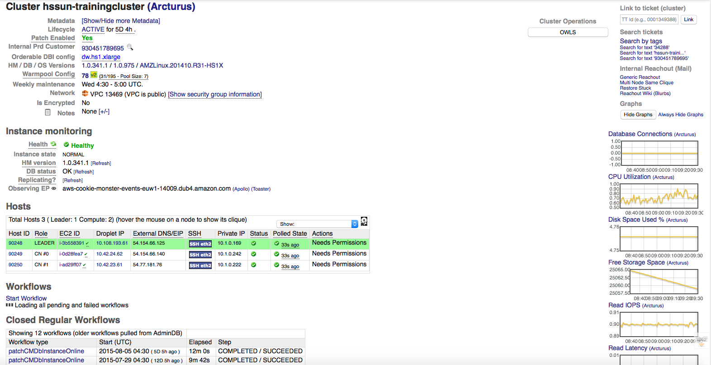
Tools
Ops Console
OWLS
No Observed Events, No Customer API history

Slide 72
What to ask customers…
Query ID! Query ID! Query ID!
Explain Plans
Screenshots/logs
Results of certain queries involving system tables
When was last time they performed maintenance
What are they trying to do (use case)
Sample data (Table DDLs, sample COPY files)
Code sample for driver issues
Check MTU and TCP Keepalive settings
Check if SAVEPOINTS are being used

Slide 73
Scenario 1
Issue: Queries are not returning back results
Possible Solution(s):
Look for your client’s MTU settings and make sure that it is set to 1500 and around 1350 for VPN and VPC Peering/ClassicLink connections. Remember to reboot after setting this value.
Check your TCP Keepalive Settings to make sure connections are not being dropped
Links:
http://docs.aws.amazon.com/redshift/latest/mgmt/connecting-drop-issues.html
http://docs.aws.amazon.com/redshift/latest/mgmt/connecting-firewall-guidance.html

Slide 74
Scenario 2
Issue: My queries are telling me that my cluster is in maintenance mode when it is not my maintenance window.
Possible Solution(s):
Monitoring system detected an issue and decided to reboot the cluster
Normally related to a missed health check due to high load
Should isolate if this is a one off event or the same query is continuously causing the crash
Optimize the workload and perform maintenance
Evaluate Workload Management
Engage support

Slide 75
Scenario 3
Issue: The INSERTs are very slow and a simple create table takes more than a minute
Possible Solution(s):
Commit Queue problem
Check the queuelen of the commit queue to see how many queries are waiting to commit before it
Group more loads together
Use COPY instead
WLM Queueing problem
Check stl_wlm_query for queueing in Workload Management
Evaluate Workload Management

Slide 76
Redshift Limits
Maximum number of tables per cluster: 9,900
Maximum number of columns per table: 1,600
Number of sortkey columns per table: 400
Maximum width of a table with fixed columns: 65535 bytes
Number of user defined databases: 60
Number of schemas per database: 256
Number of concurrent user connections: 500
Workload Management can have maximum concurrency of 50 across all queues
Number of AWS Accounts you can share a snapshot with: 20
Maximum size of a single row loaded by COPY: 4MB
Maximum size of a SQL Query statement: 16MB

Slide 77
Unsupported Features
Based on PostgreSQL 8.0.2 with some key differences
Constraint Enforcement and checks
Tablespaces/Partitioning/Inheritance
Stored Procedures and Triggers
Table Functions
Full Text Search
Indexes
ALTER TABLE.. ALTER COLUMN
SAVEPOINTS
Link with full list:
http://docs.aws.amazon.com/redshift/latest/dg/c_unsupported-postgresql-features.html

Slide 78
Q&A

